Slide 1


scTalk 2: Open Problems in Single-Cell Analysis
Arash B. Abadi
Dec 16, 2025

Slide 2
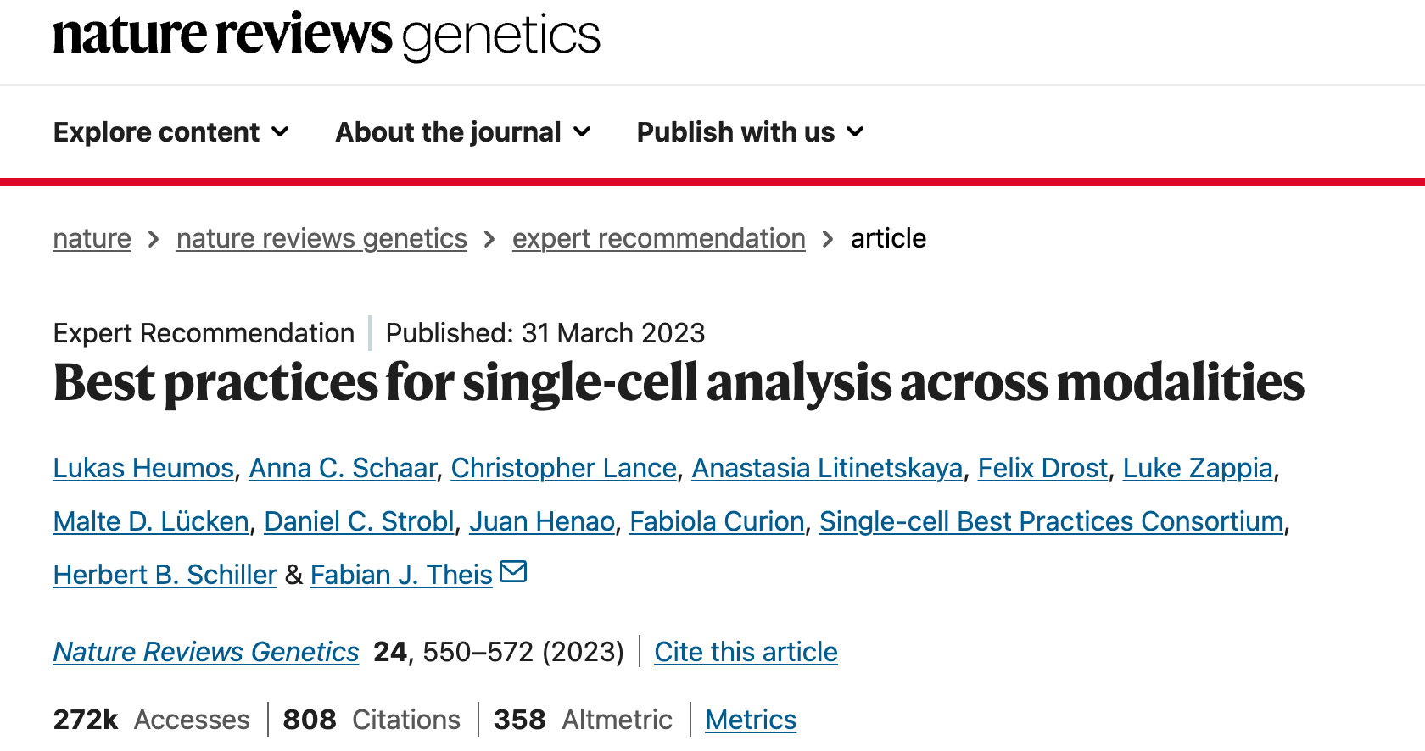
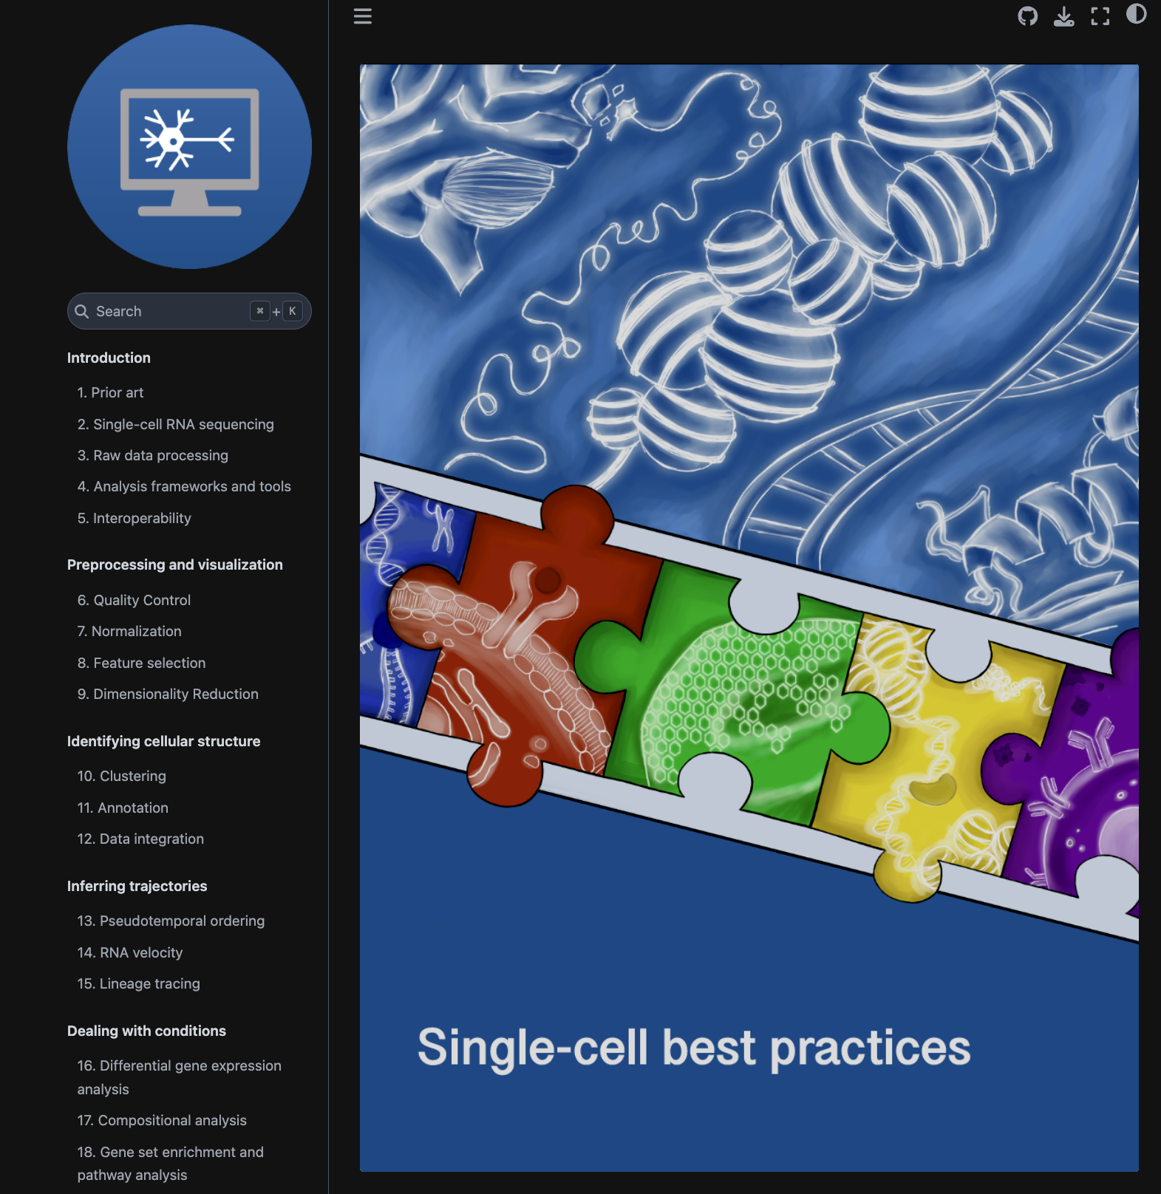
scTalk1
https://www.nature.com/articles/s41576-023-00586-w

Slide 3
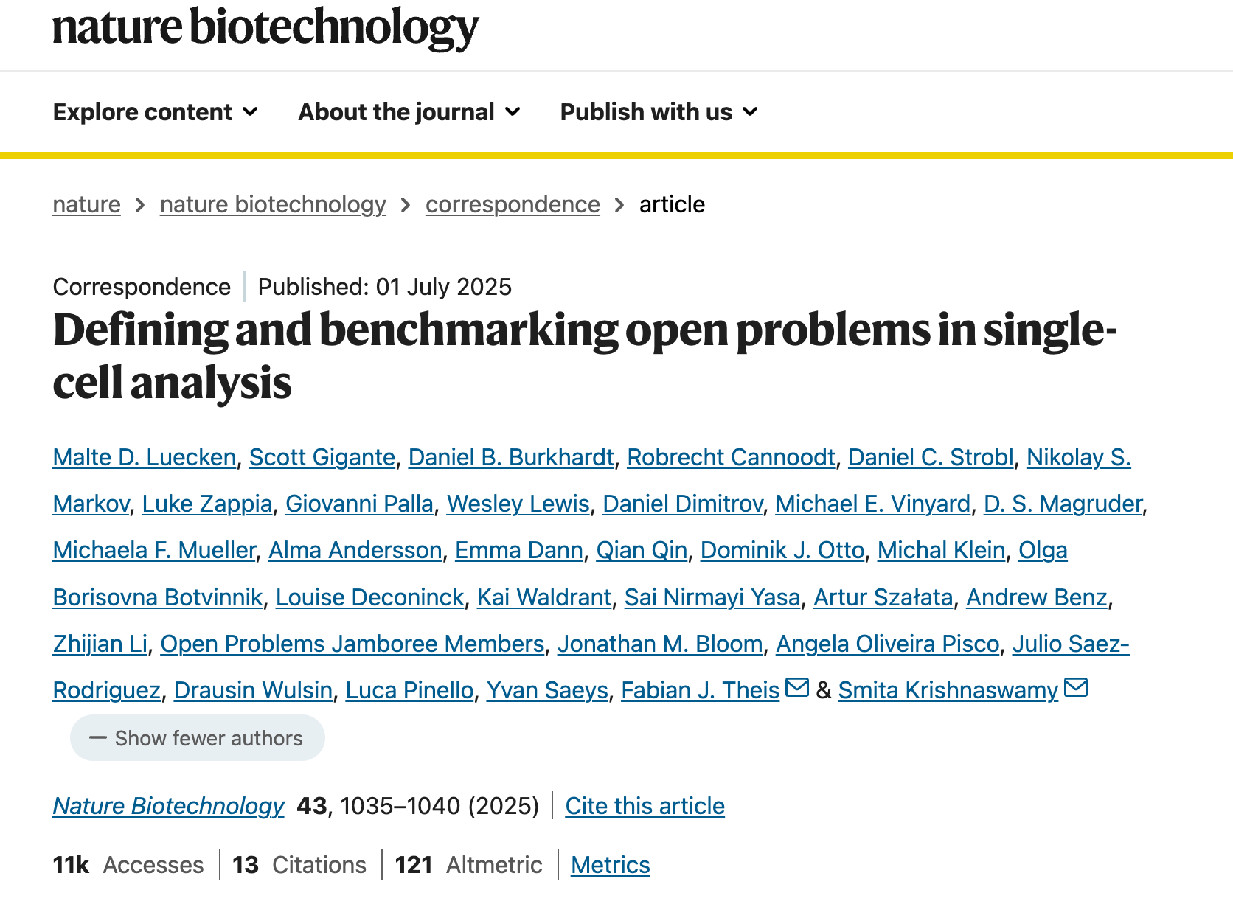

openproblems.bio
Helmholtz Munich & Yale

Slide 4
Why we need uniform, live, independent, and standardized benchmarks?
Bespoke benchmarks set up by method developers to evaluate newly developed algorithms often include datasets and metrics chosen to highlight the advantages of their tools, which has been shown to lead to less objective assessments^{6,7}. Even if datasets and metrics are standardized, historical analysis shows that when benchmarks are implemented by the same groups introducing new methods, the evaluations tend to inflate performance of the newest models via custom hyperparameter selection and data processing⁸.
… efforts aim to systematically evaluate the current state of the art in a given area and may be less biased. However, their results are static and inevitably age.
… datasets and metrics typically have less than 10% overlap between benchmarks¹³.

Slide 5
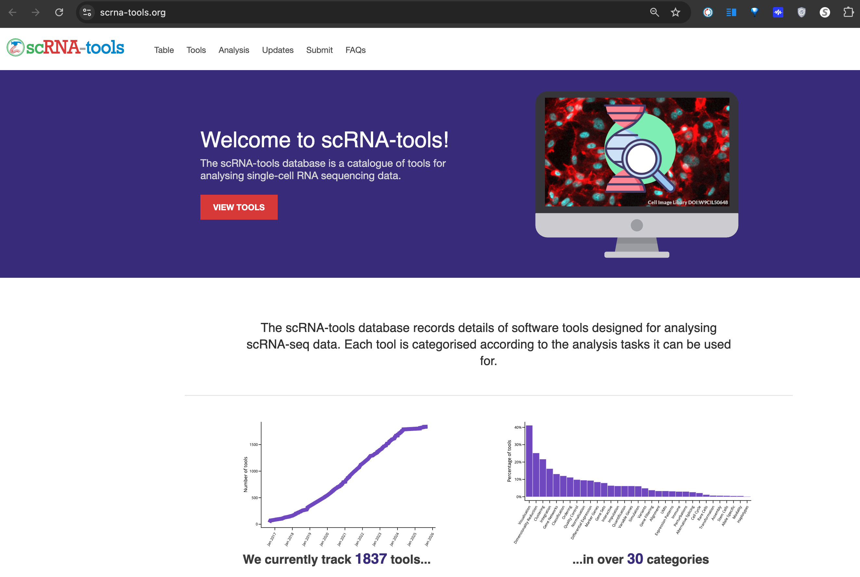
Over 1800 Published Algorithms for single-cell Analysis
https://www.scrna-tools.org

Slide 6
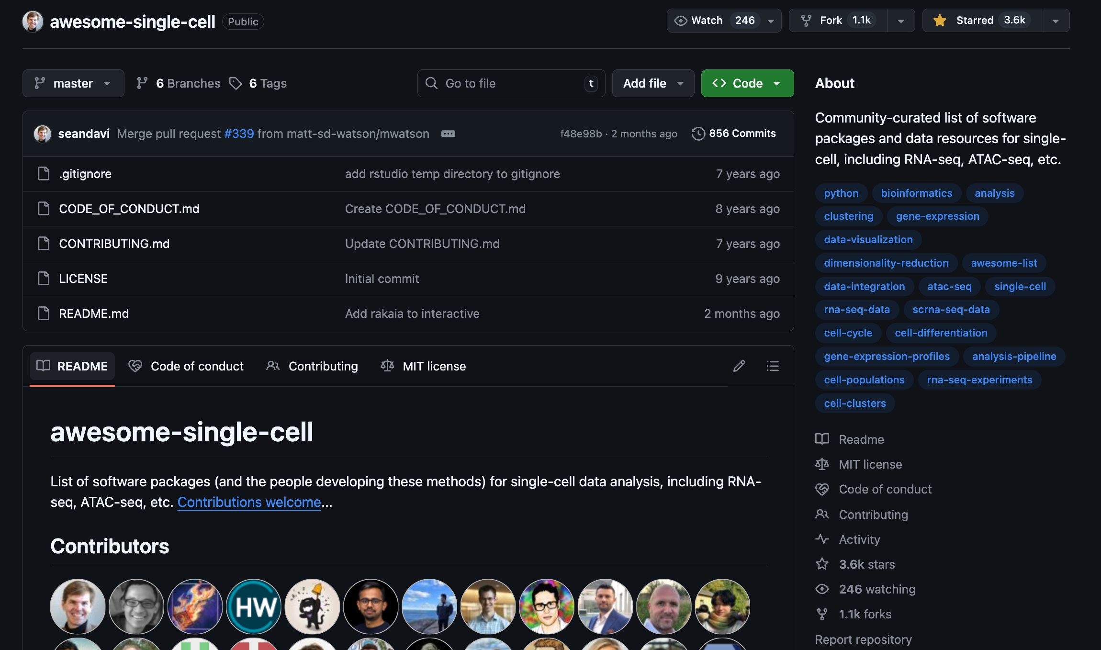
“awesome-single-cell" GitHub collection as a common compilation of single-cell methods
https://github.com/seandavi/awesome-single-cell
https://notebooklm.google.com/notebook/ab5c5e5c-6907-4883-8918-f4868f15ff88

Slide 7
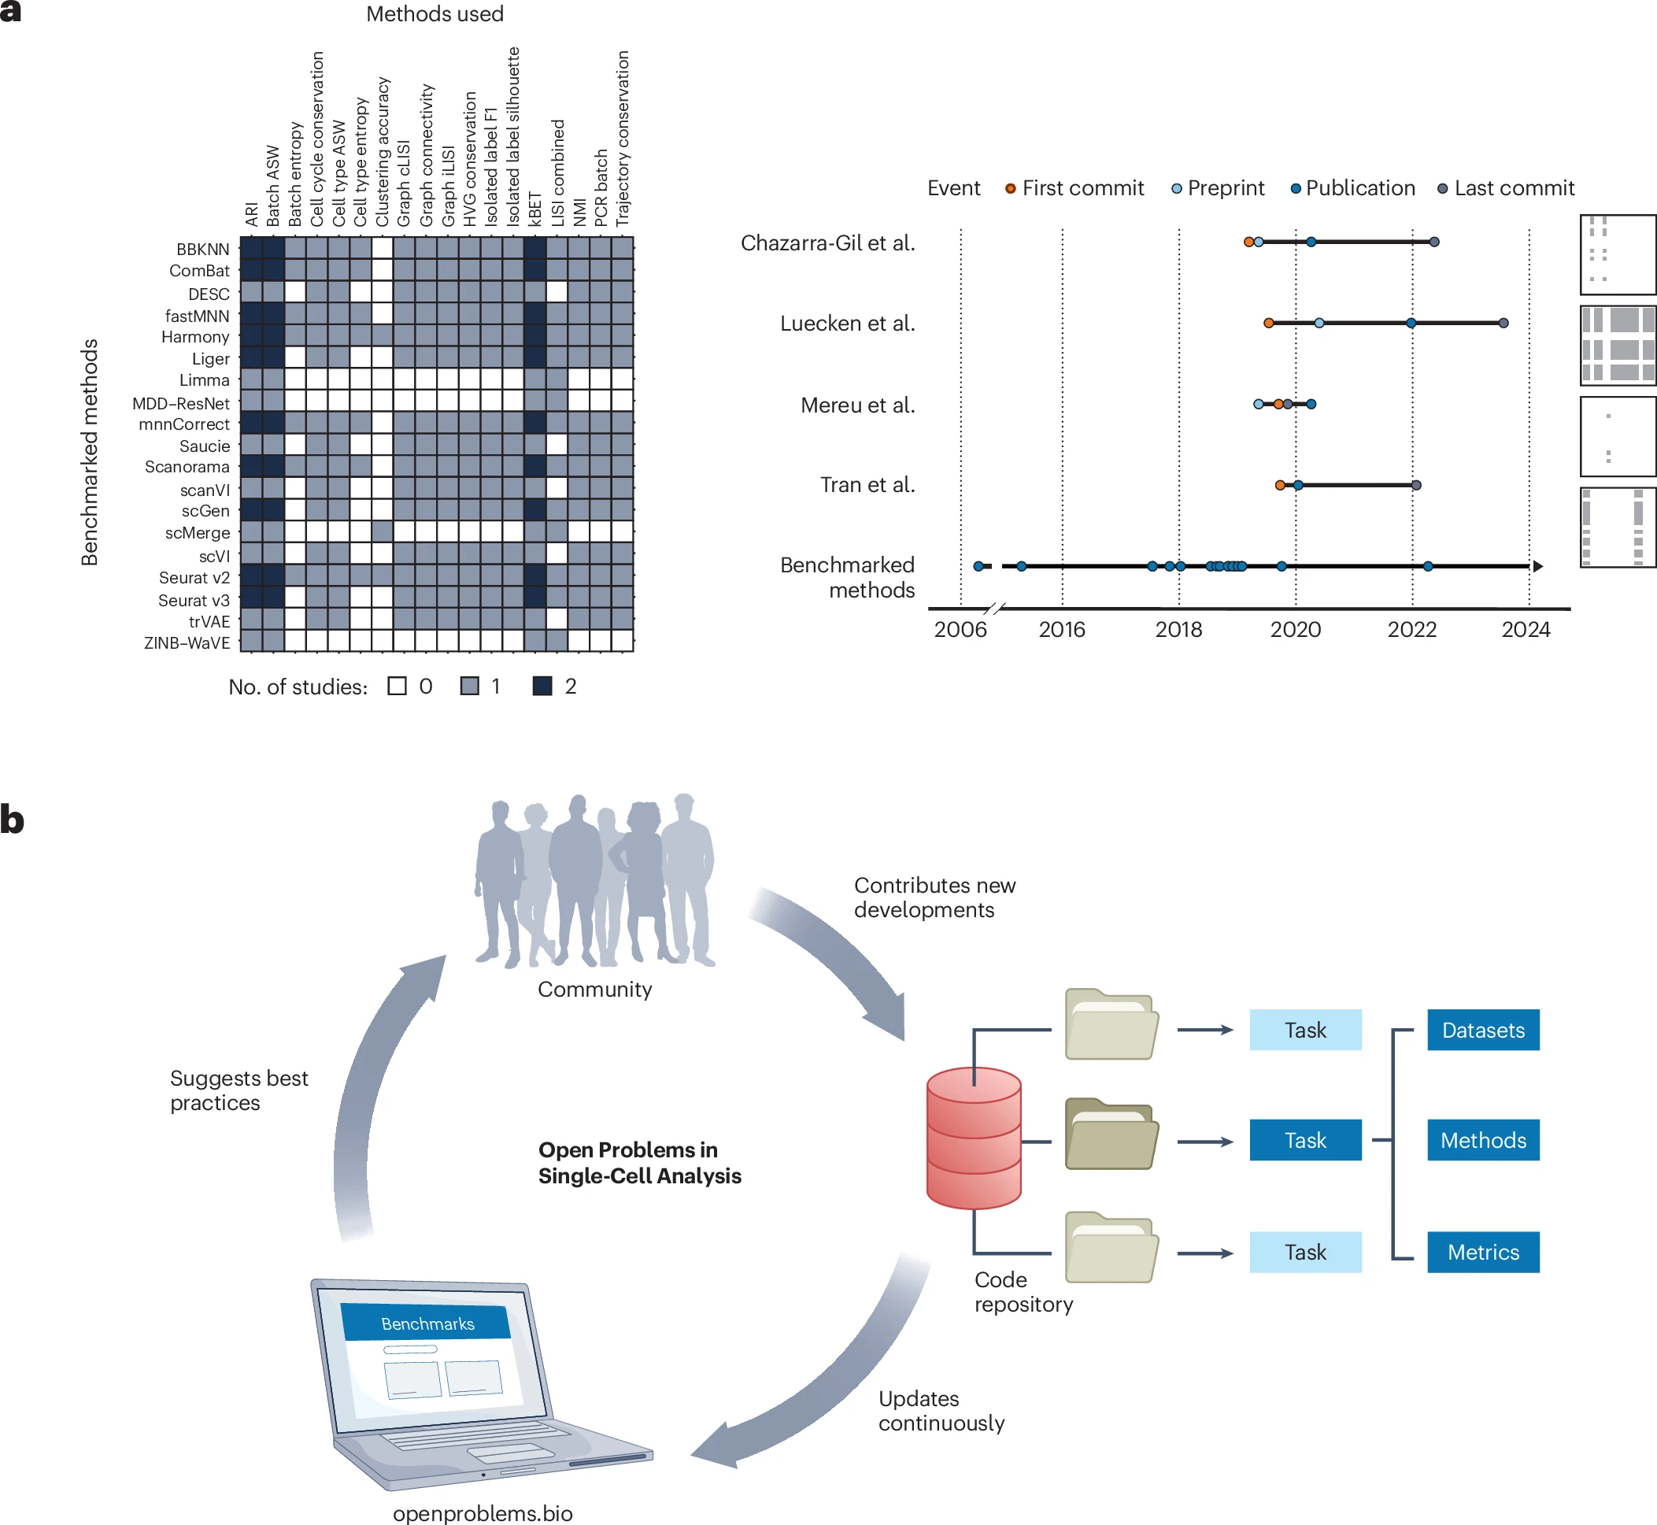
Fig. 1: The Open Problems in Single-cell Analysis living benchmarking platform
Notes:
a, Overview and timeline of published benchmarks of single-cell batch integration. Four publications have benchmarked 19 methods using 18 metrics. Light gray and black squares indicate whether one or two benchmarks include this method–metric combination (left). Arrows indicate the range of publication times of methods included in the benchmark. b, The Open Problems platform. The Open Problems platform consists of tasks that are broken down into datasets, methods and metrics. The community contributes code to these tasks in the platform, which uses these contributions to extend the benchmarks that are run and pushed to the Open Problems website. The community can then consult the website for guidance on method selection.

Slide 8
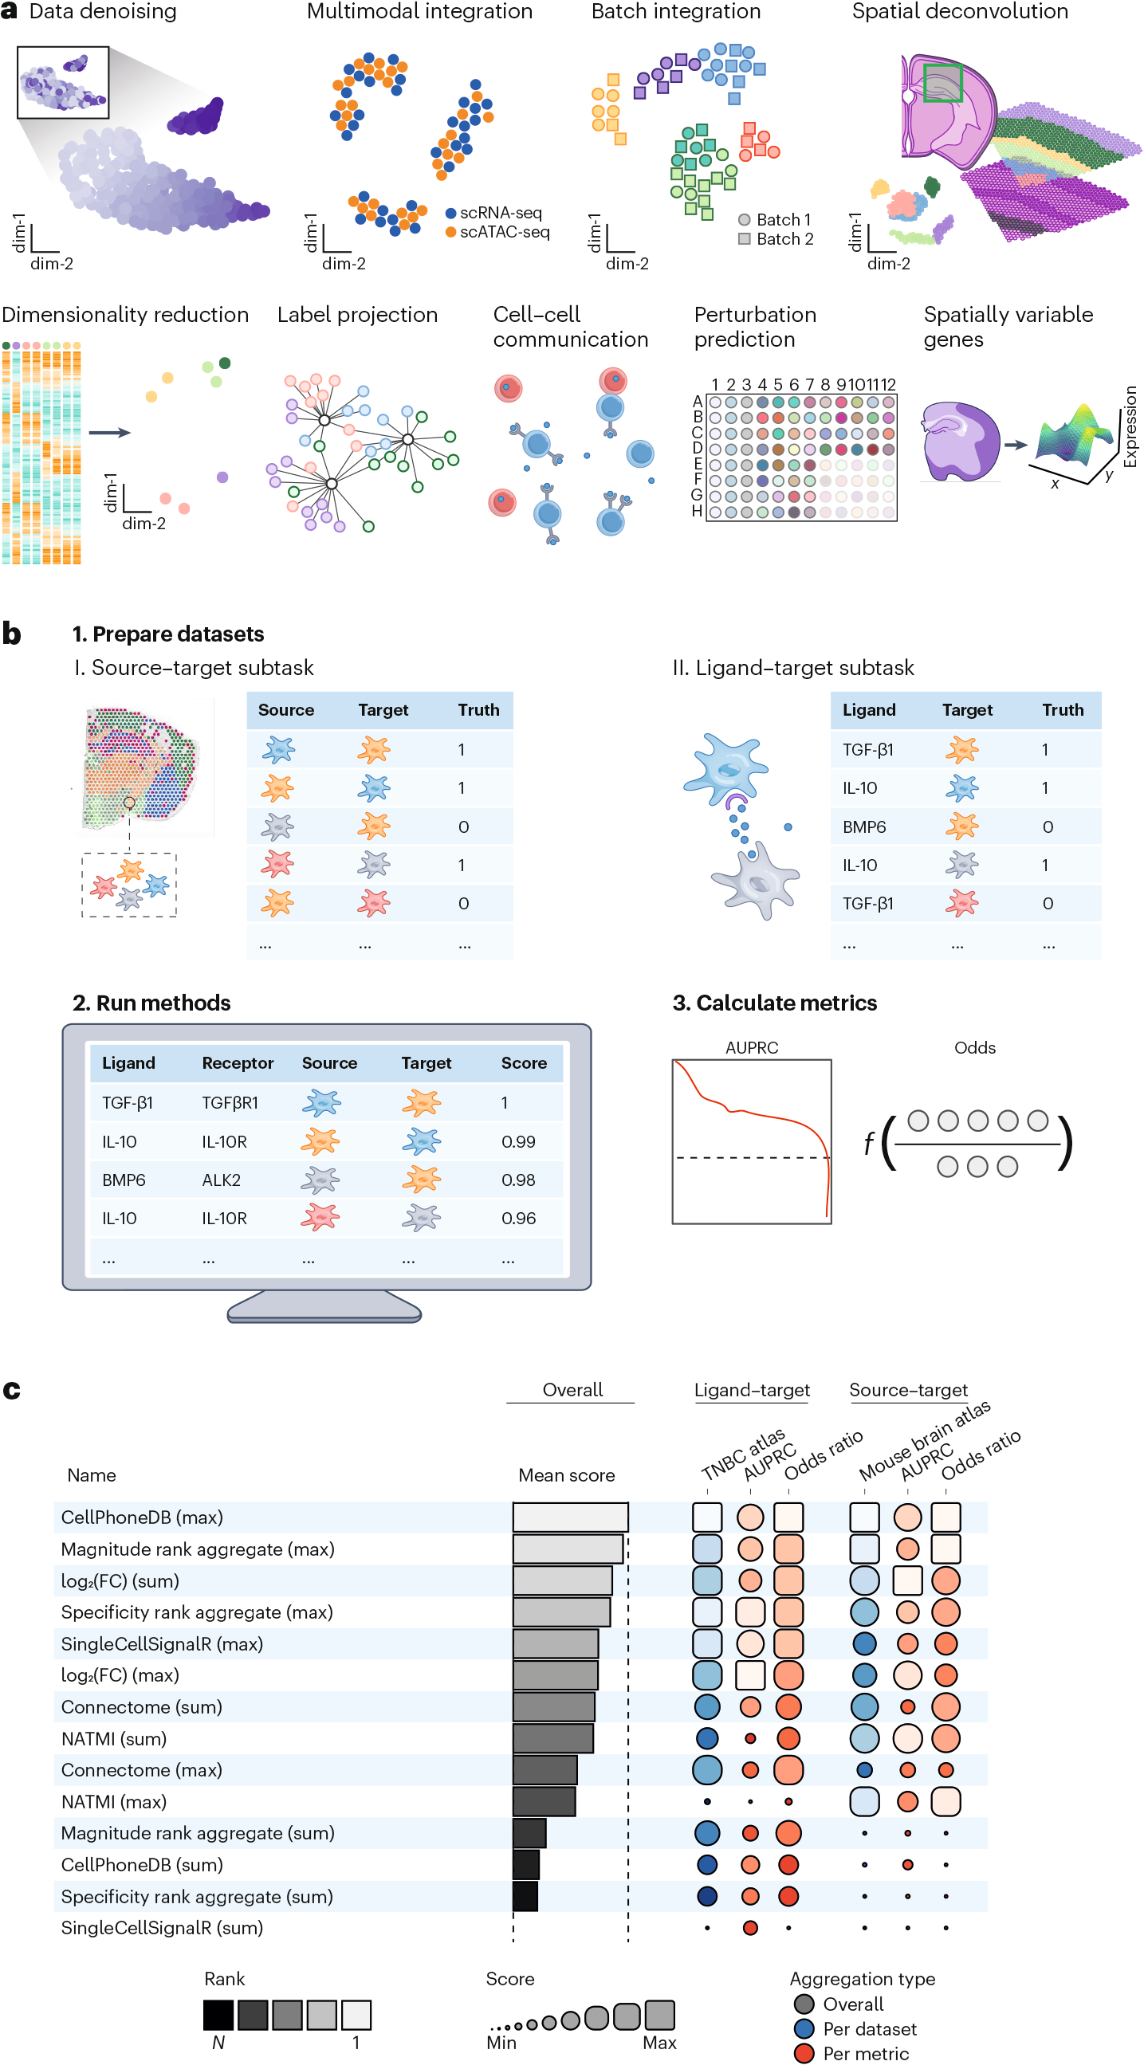
Fig. 2: Task overview, setup and results.
Notes:
a, Overview of the 9 tasks currently included in the Open Problems platform. Batch integration and cell–cell communication (CCC) consist of 3 and 2 subtasks, respectively, making up the current total of 12 tasks.

Slide 9
Fig. 2: Task overview, setup and results.
Notes:
b, The CCC task. This task includes two subtasks defined by different types of ground truth: spatial cell type co-localization in the source–target subtask and cytokine profiling in the ligand–target subtask. Methods are run on each subtask to score the likelihood of interaction between source and target cell types or ligand and target cell types. Finally, the area under the precision–recall curve (AUPRC) and the odds ratio of true to false positive interactions in the top 5% of predicted pairs are used to score method outputs (Supplementary Note 1.1).

Slide 10
Fig. 2: Task overview, setup and results.
Notes:
c, Collated results of the two CCC subtasks. Methods are ranked using the mean of the overall score for each subtask (shown as “TNBC atlas” and “Mouse brain atlas” blue boxes, respectively). These overall scores are computed as the mean of all scaled metric results (red boxes). Linear scaling is performed using random and perfect baseline methods, whose performances are set to 0 and 1, respectively (see Supplementary Methods). The results shown here are from Open Problems v1 (ref. ²⁴).

Slide 11
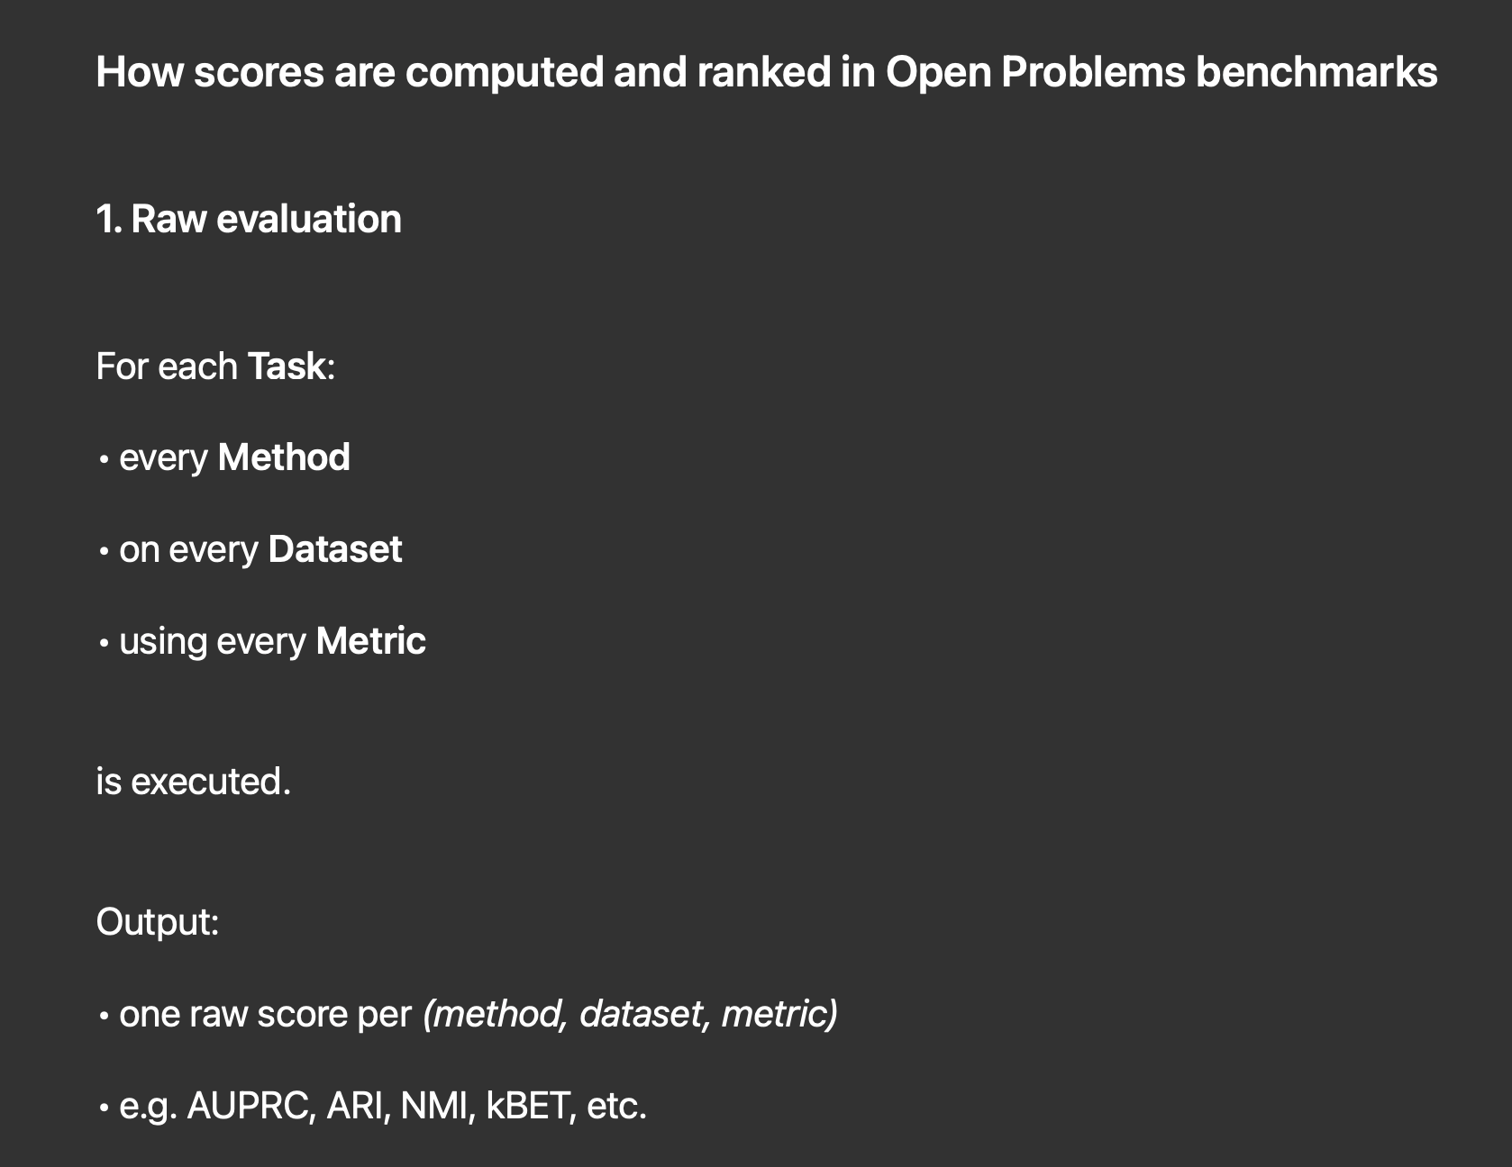
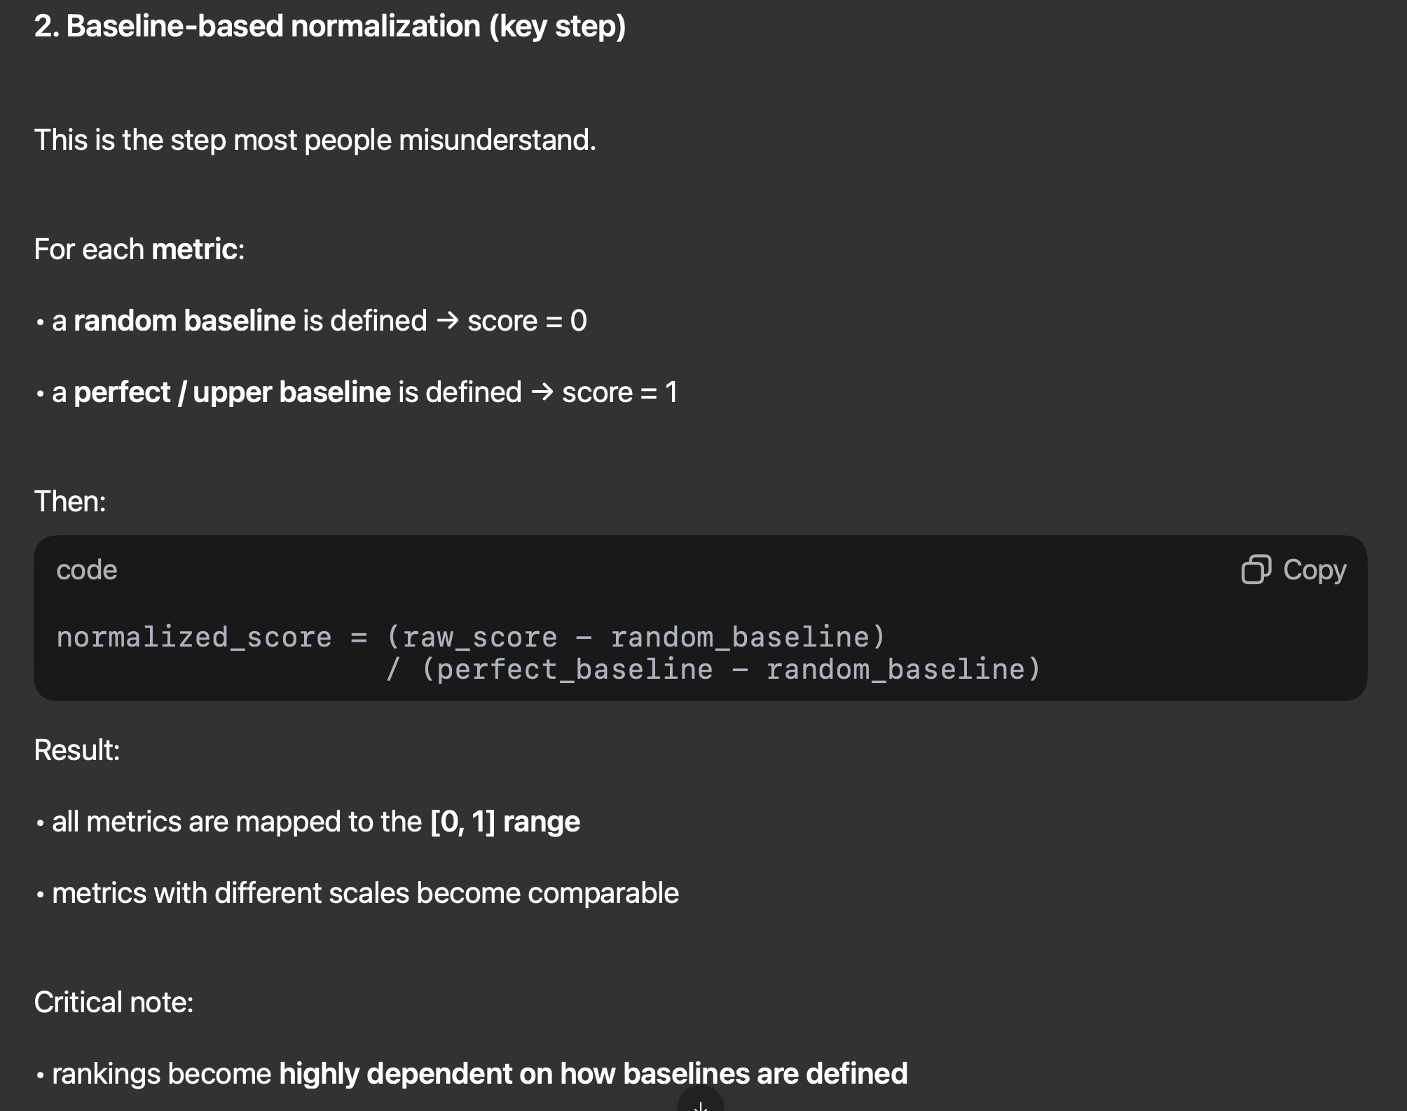
How scores are computed and ranked in Open Problems benchmarks?
Notes:
c, Collated results of the two CCC subtasks. Methods are ranked using the mean of the overall score for each subtask (shown as “TNBC atlas” and “Mouse brain atlas” blue boxes, respectively). These overall scores are computed as the mean of all scaled metric results (red boxes). Linear scaling is performed using random and perfect baseline methods, whose performances are set to 0 and 1, respectively (see Supplementary Methods). The results shown here are from Open Problems v1 (ref. ²⁴).

Slide 12
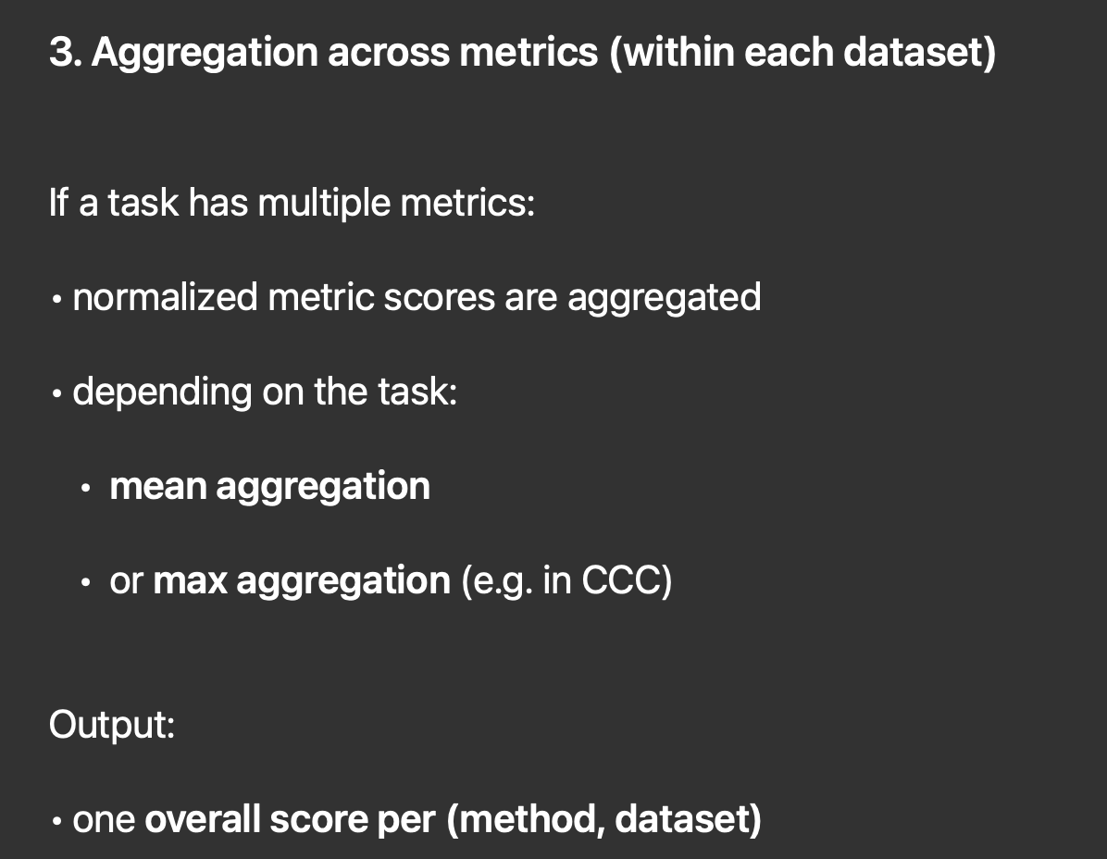
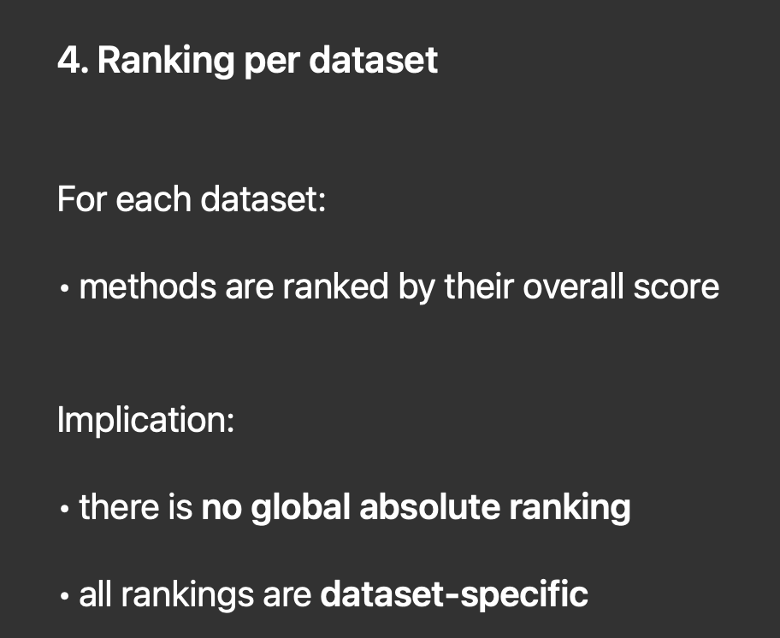
How scores are computed and ranked in Open Problems benchmarks?
Notes:
c, Collated results of the two CCC subtasks. Methods are ranked using the mean of the overall score for each subtask (shown as “TNBC atlas” and “Mouse brain atlas” blue boxes, respectively). These overall scores are computed as the mean of all scaled metric results (red boxes). Linear scaling is performed using random and perfect baseline methods, whose performances are set to 0 and 1, respectively (see Supplementary Methods). The results shown here are from Open Problems v1 (ref. ²⁴).

Slide 13
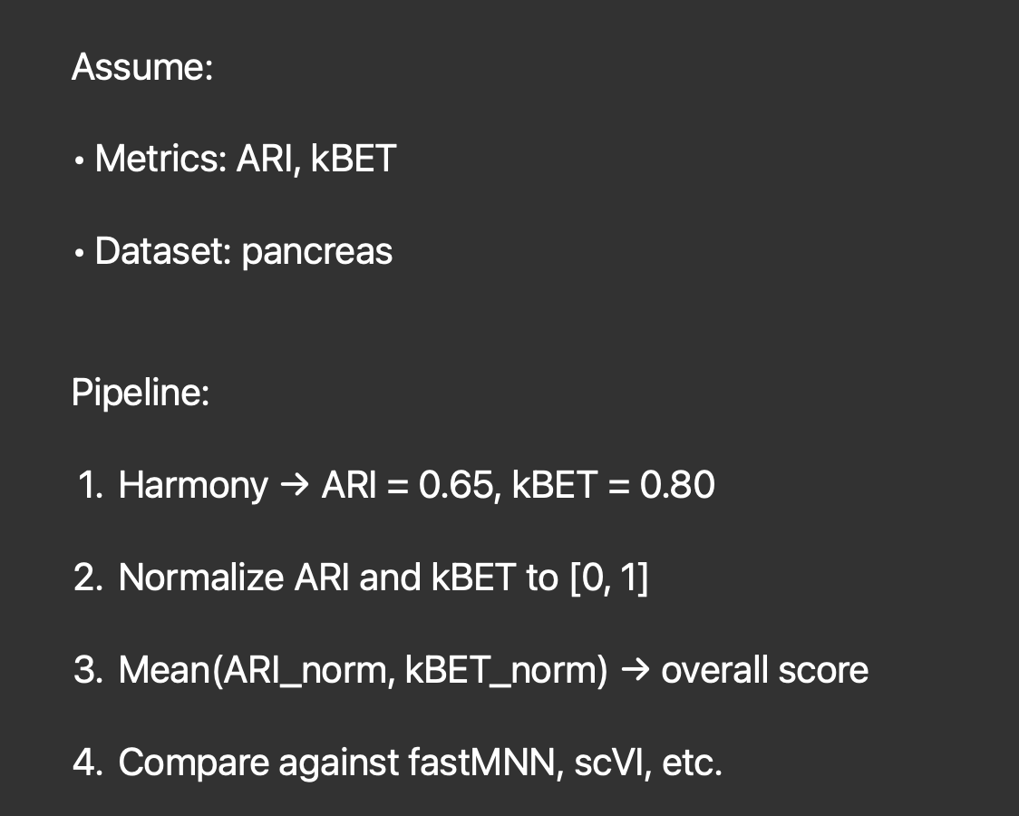
Simple example (batch integration)

Slide 14
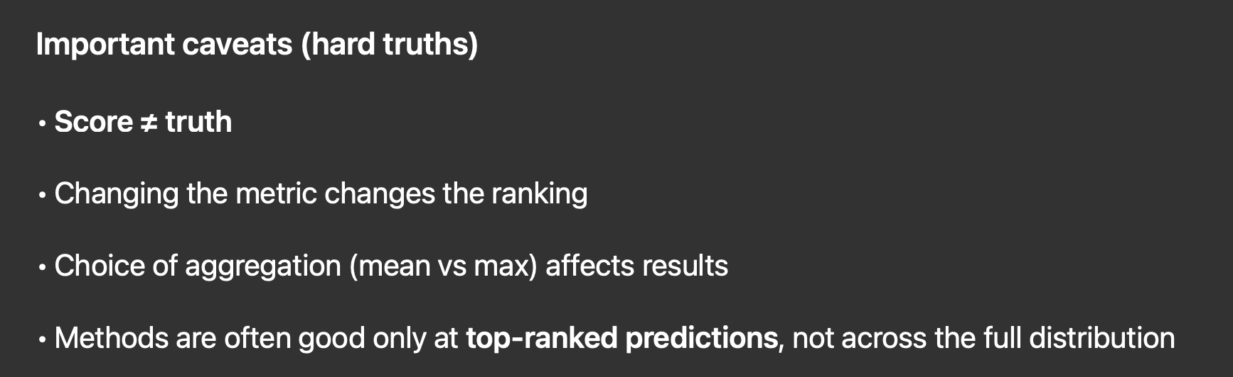
Final score = raw metric → baseline normalization → aggregation → per-dataset ranking

Slide 15
From a software engineering perspective, the work is clean and mature!
Notes:
c, Collated results of the two CCC subtasks. Methods are ranked using the mean of the overall score for each subtask (shown as “TNBC atlas” and “Mouse brain atlas” blue boxes, respectively). These overall scores are computed as the mean of all scaled metric results (red boxes). Linear scaling is performed using random and perfect baseline methods, whose performances are set to 0 and 1, respectively (see Supplementary Methods). The results shown here are from Open Problems v1 (ref. ²⁴).

Slide 16
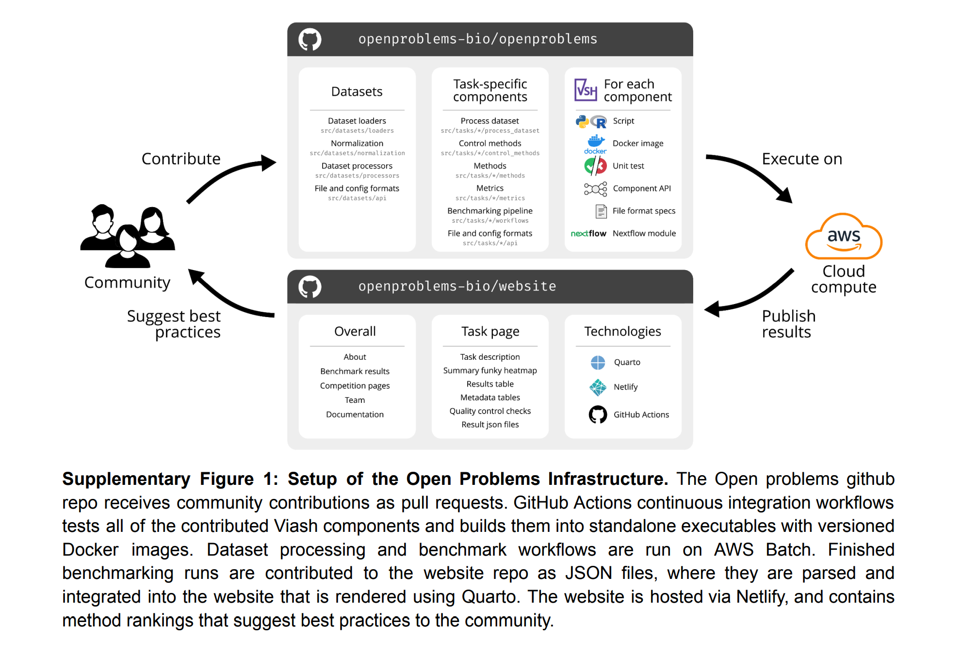
Notes:
c, Collated results of the two CCC subtasks. Methods are ranked using the mean of the overall score for each subtask (shown as “TNBC atlas” and “Mouse brain atlas” blue boxes, respectively). These overall scores are computed as the mean of all scaled metric results (red boxes). Linear scaling is performed using random and perfect baseline methods, whose performances are set to 0 and 1, respectively (see Supplementary Methods). The results shown here are from Open Problems v1 (ref. ²⁴).

Slide 17
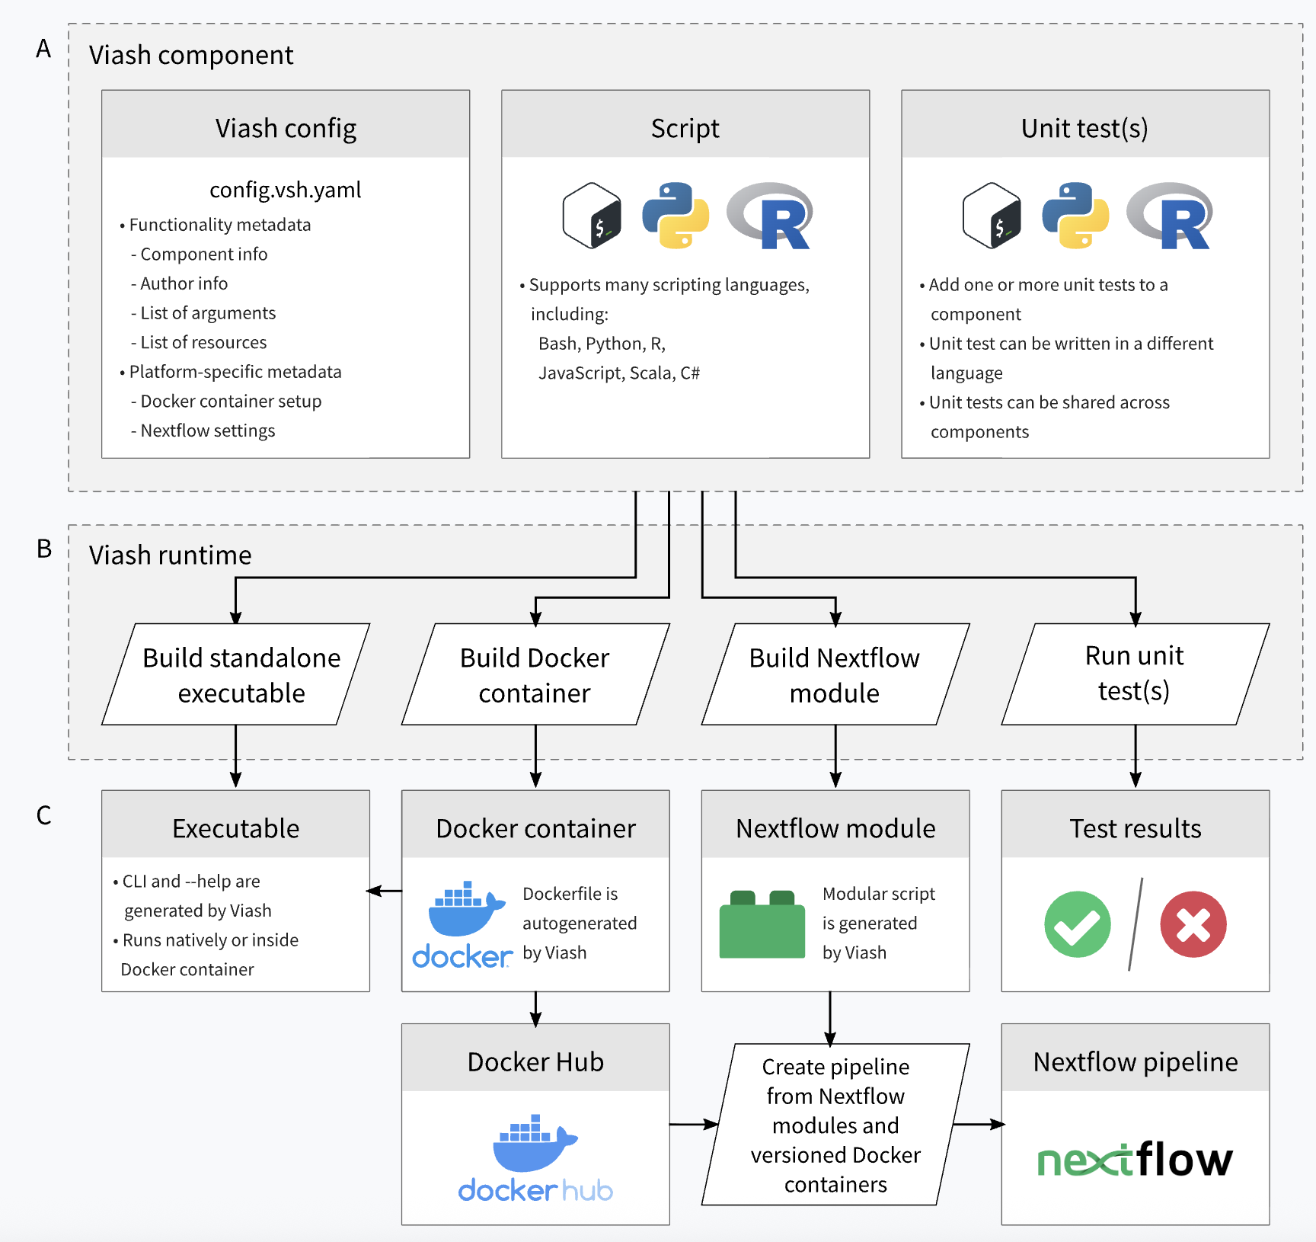
https://viash.io
Notes:
c, Collated results of the two CCC subtasks. Methods are ranked using the mean of the overall score for each subtask (shown as “TNBC atlas” and “Mouse brain atlas” blue boxes, respectively). These overall scores are computed as the mean of all scaled metric results (red boxes). Linear scaling is performed using random and perfect baseline methods, whose performances are set to 0 and 1, respectively (see Supplementary Methods). The results shown here are from Open Problems v1 (ref. ²⁴).

Slide 18
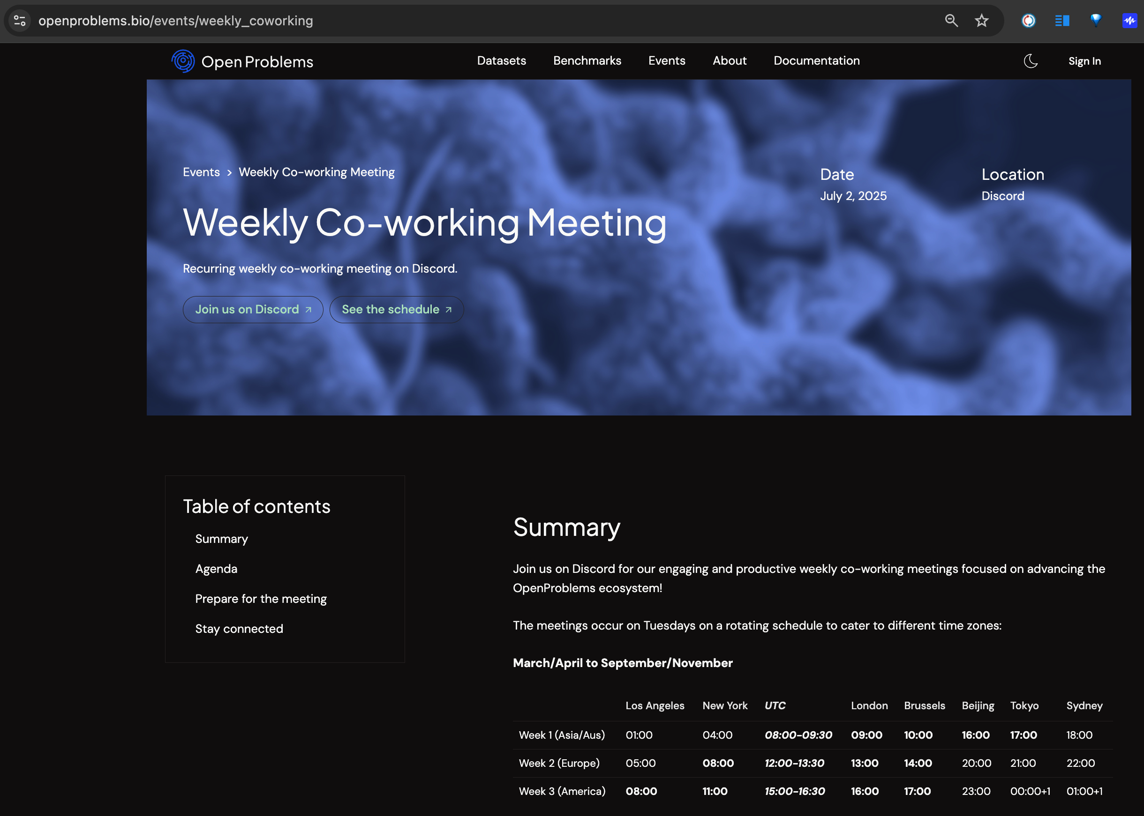
Open Problems Weekly Meetings
https://openproblems.bio/events/weekly_coworking

Slide 19

Open Problems Discord Server
https://discord.com/invite/PEmRN4tjvE

Slide 20

Thank you!
scTalk is:
Discussion-driven single-cell journal club
Break down key/new papers
Shared standards and critical thinking in analysis
Open questions, interruptions, and debate encouraged
Please Sign-in + Comments & Questions

Slide 21
Supp Slides

Slide 22
Single Cell 101 for Engineers

Slide 23
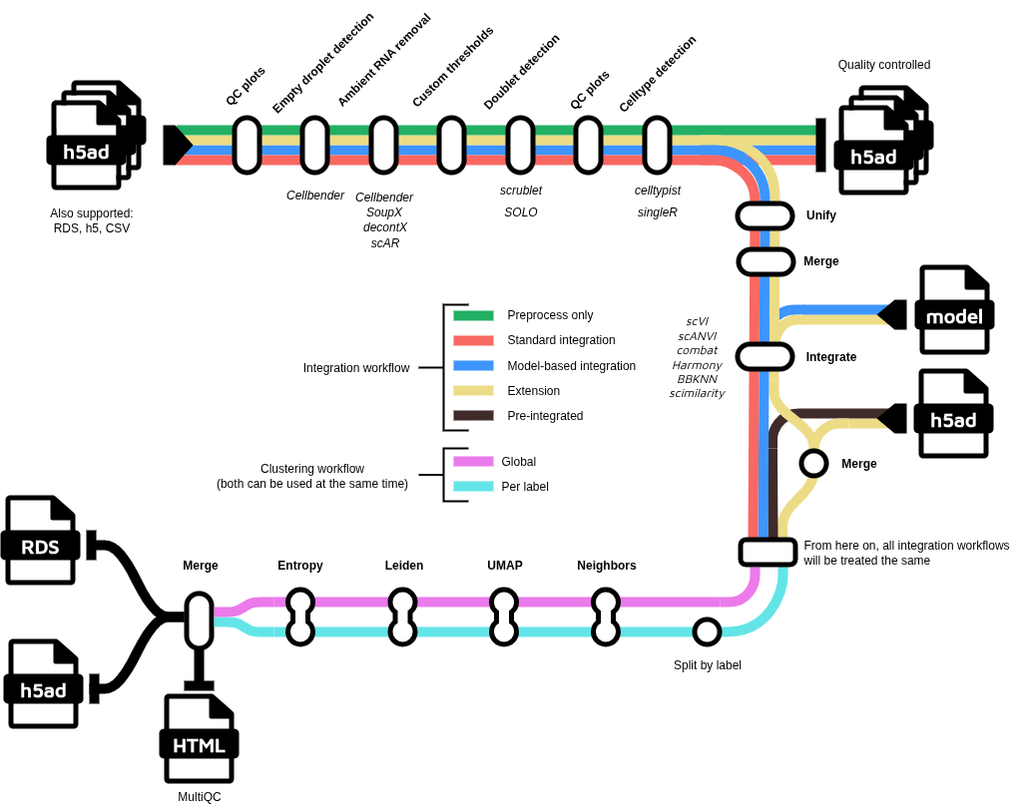
nf-core/scdownstream
https://nf-co.re/scdownstream/dev/

Slide 24

The Body as a Country!
Body = USA
Organs = States with specialized roles (Brain, Heart, Lungs, etc.)
Tissues = Cities (Cardiac muscle, Alveolar tissue, etc.)
Niche = Neighborhoods
Cells = Buildings / Organizations / Companies

Slide 25
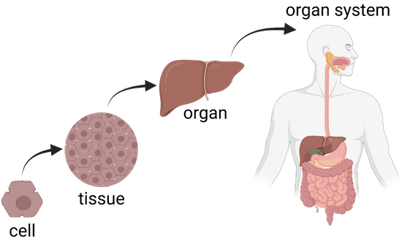
Cells coordinate to keep each “city” functioning!
A cell is the basic membrane-bound unit that contains the fundamental molecules of life and of which all living things are composed.
A single cell is often a complete organism in itself.
https://www.britannica.com/science/cell-biology
https://www.khanacademy.org/

Slide 26
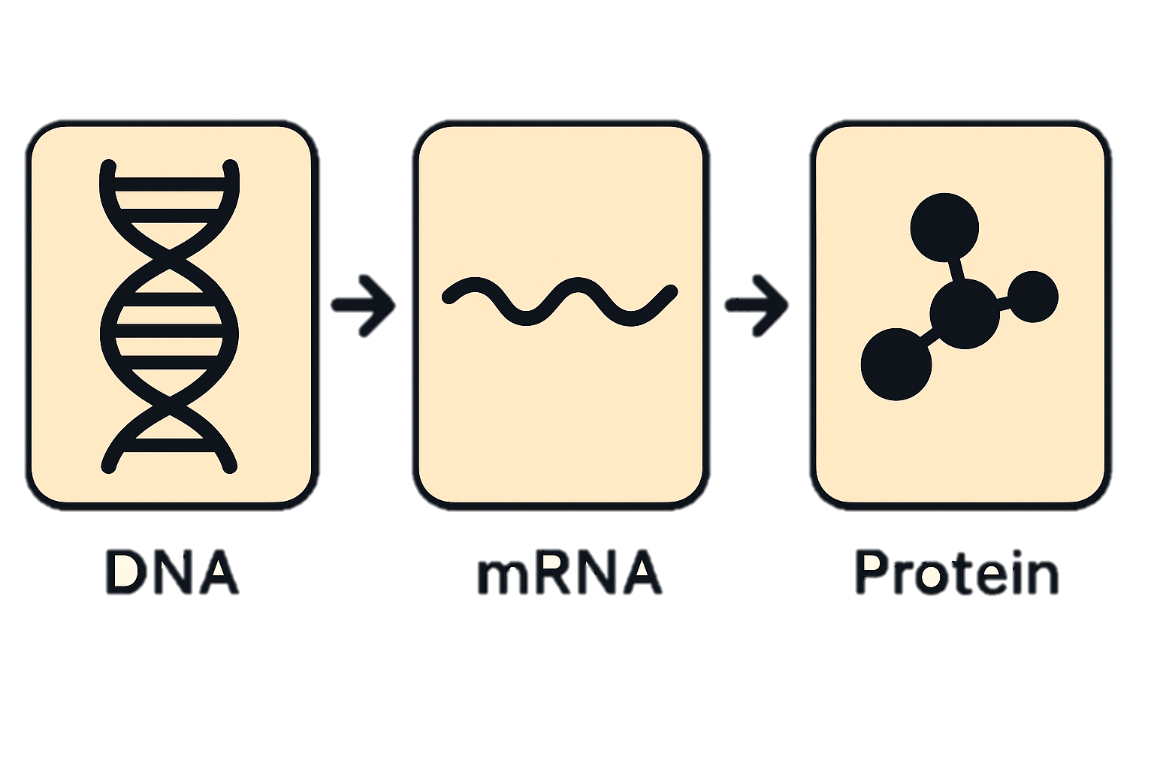

Every cell = a self-run organization inside the city
DNA = full archive of laws and manuals
Genes = individual regulations
mRNA = copied memos for active tasks
Proteins = workers, machines, and tools
Signals = inter-building communication

Slide 27
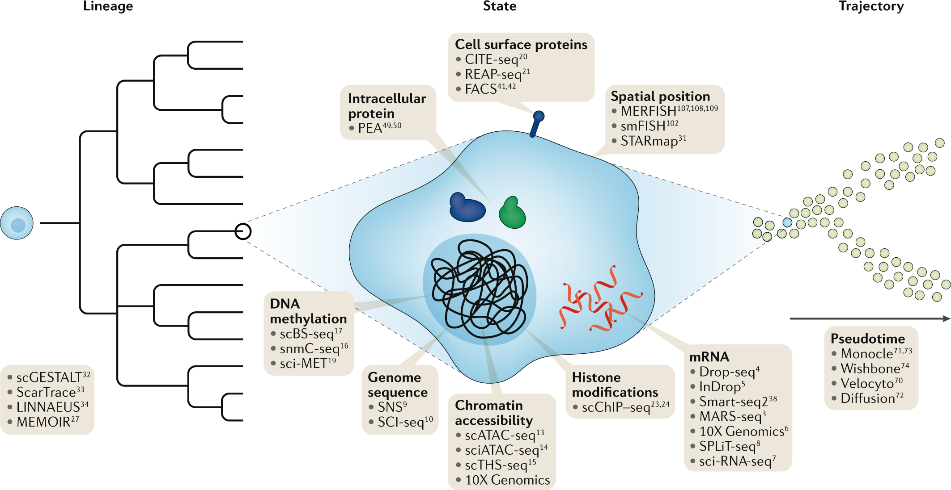
Proteomics = Workers, Machines, and Tools Operating in the Company
Metabolomics = Fuel, Supplies, Raw Materials, Waste
Genomics = The Full Law Book + Master Manuals
Transcriptomics (RNA-seq) = Memos Being Copied & Circulated
Epigenomics = Access Control + Bookmarks + Locked Archives
Stuart and Satija. Nature Reviews Genetics. 20:257-272. May 2019

Slide 28
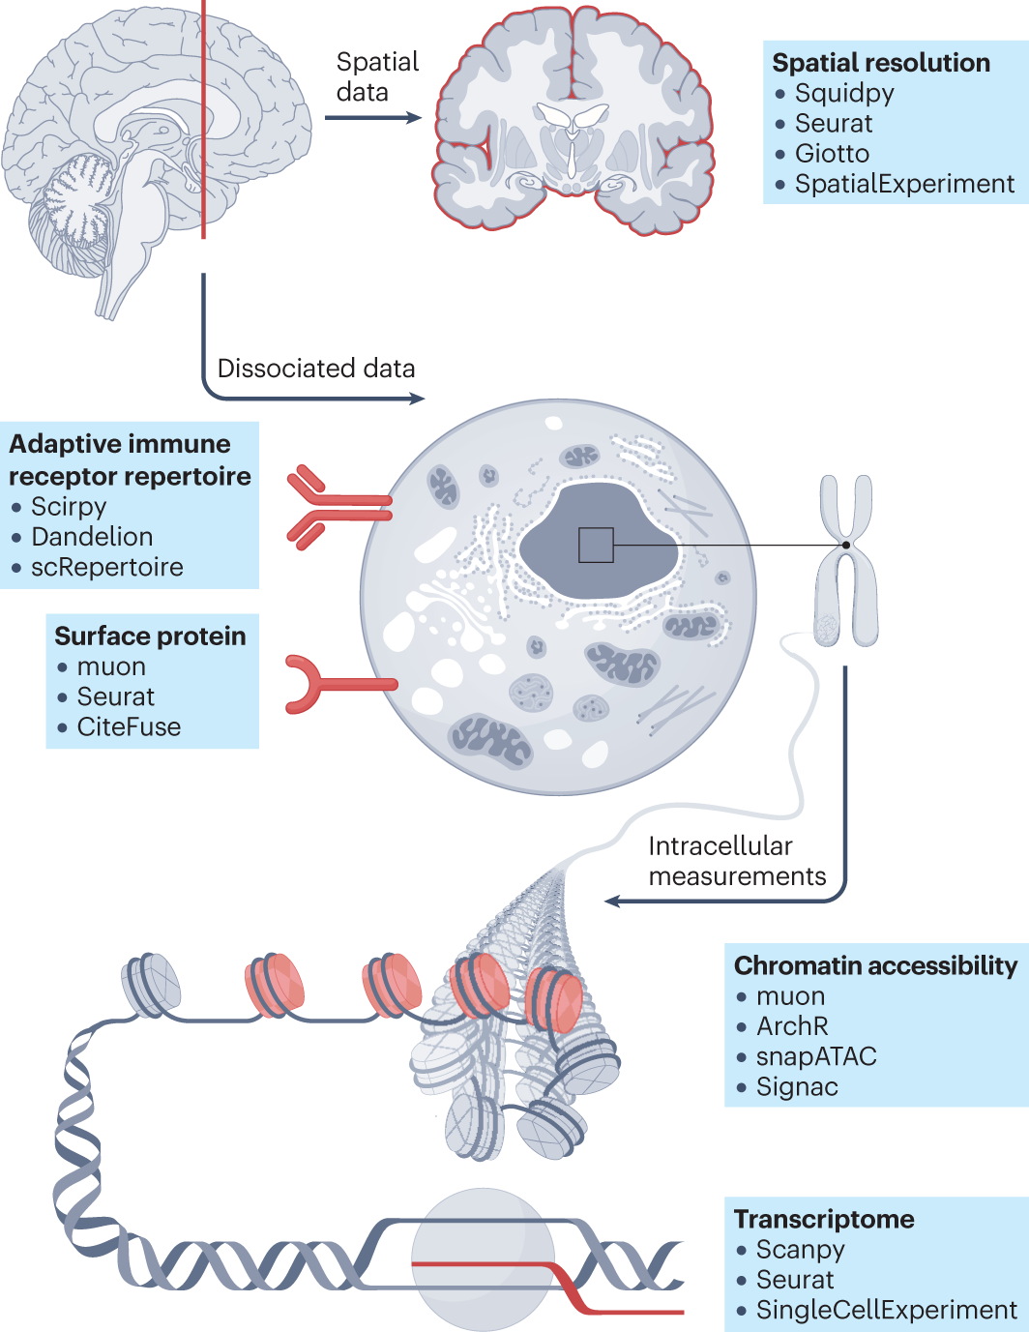





Fig1. Single-cell analysis across modalities
in
in
( )

Slide 29
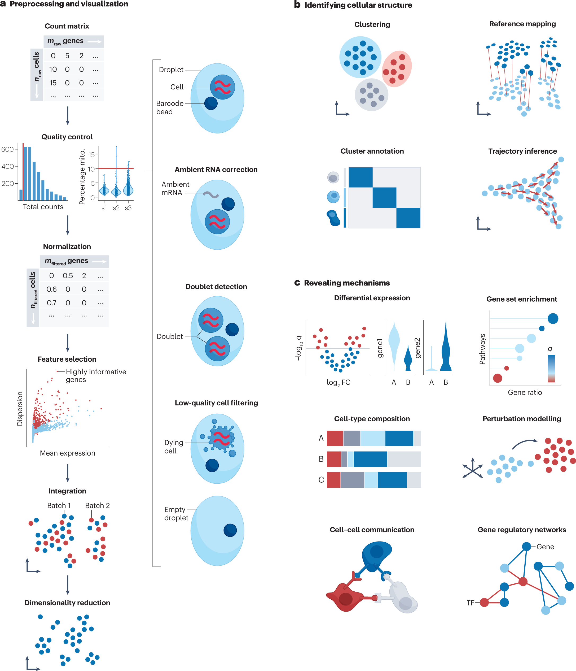
Fig2. Overview of unimodal analysis steps for scRNA-seq

Slide 30
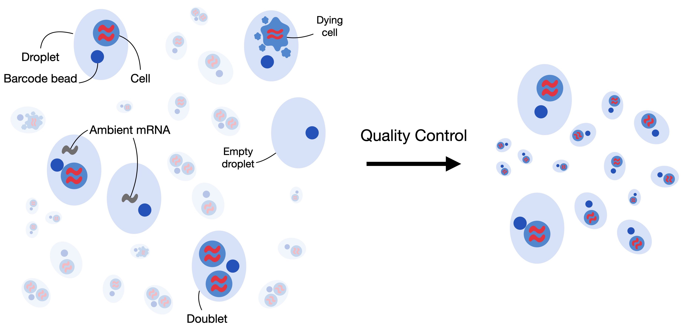
Fig. 6.1 low-quality cells, cell-free RNA and doublets (Book)

Slide 31
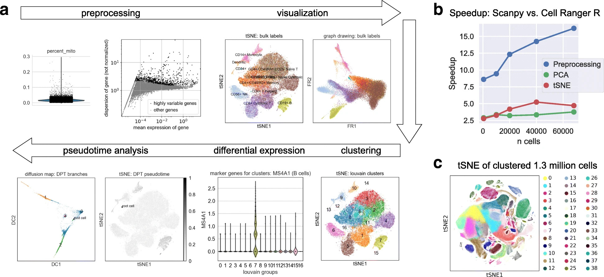
Fig. 4.2 scanpy overview (Book)

Slide 32
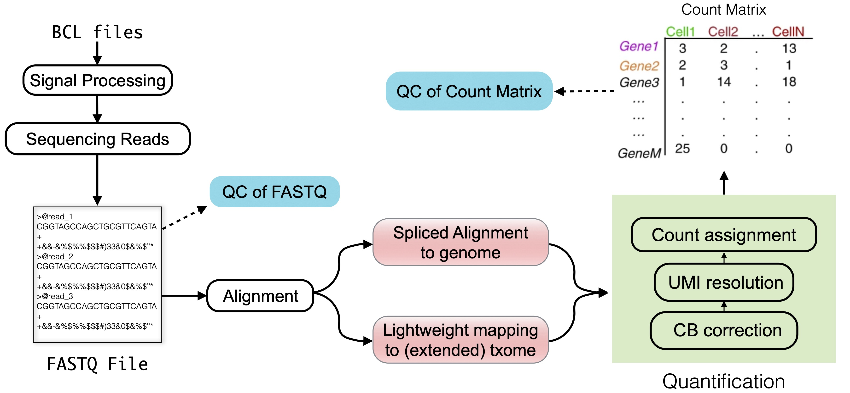
Fig. 3.1 (Book)
“txome” stands for transcriptome

Slide 33
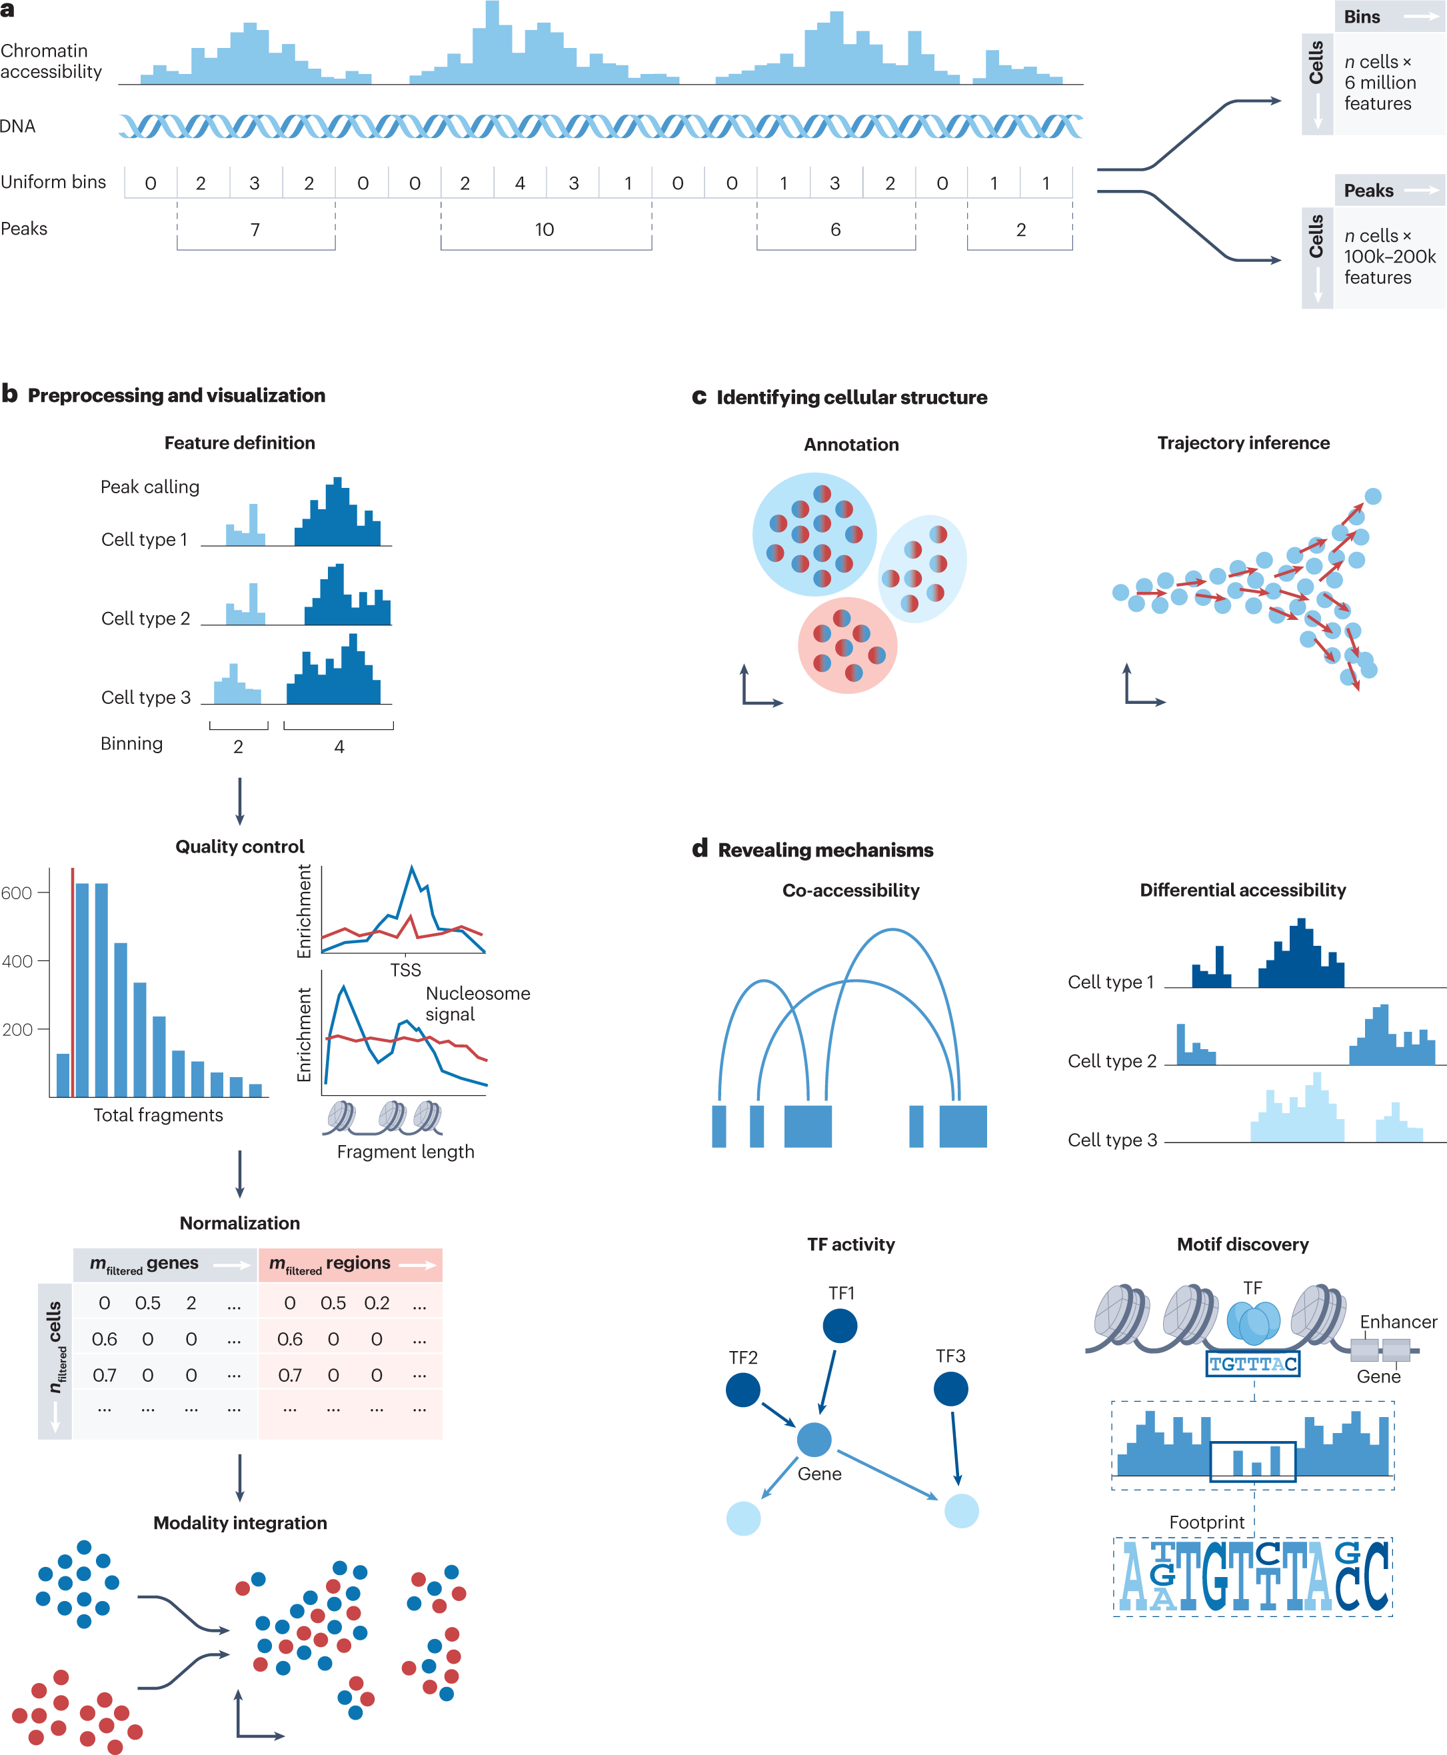
Fig. 3: Overview of scATAC-seq analysis steps

Slide 34
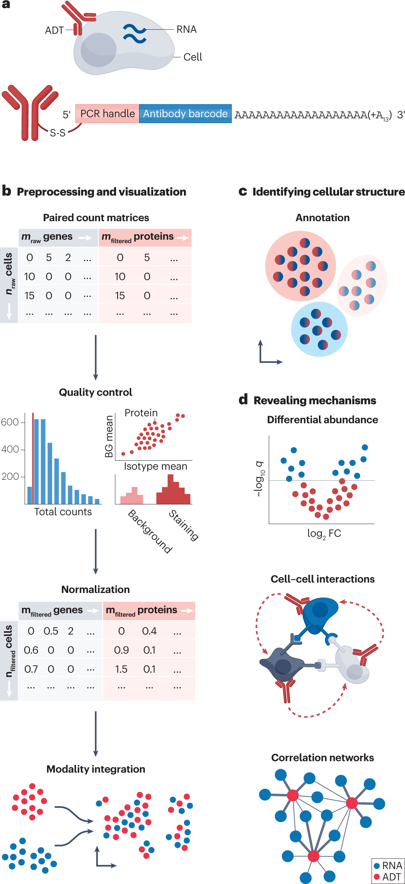
Fig. 4: Overview of CITE-seq data processing

Slide 35
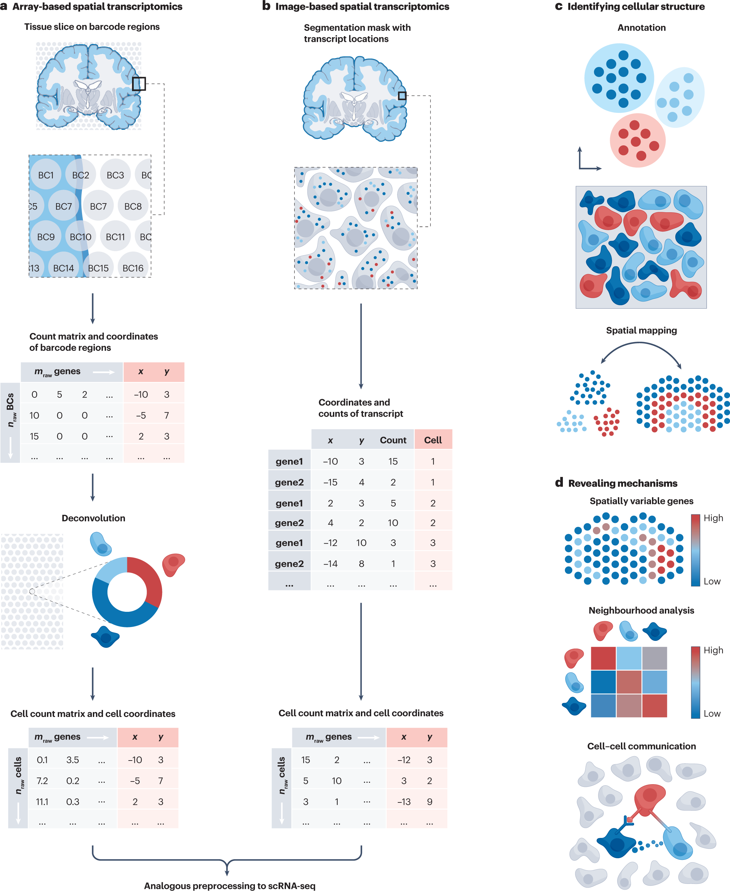
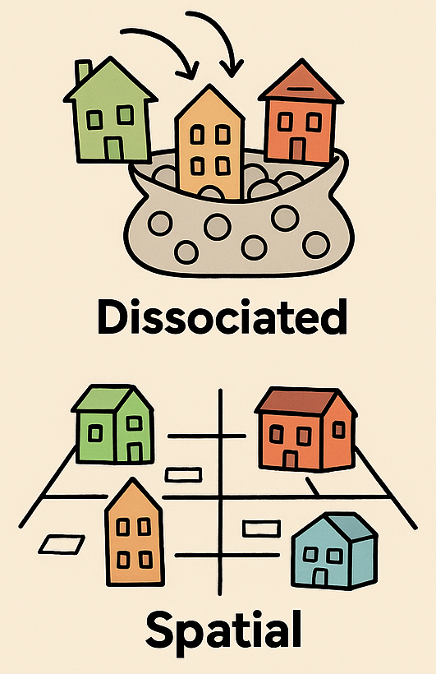
Fig. 6: Overview of spatial transcriptomics preprocessing and downstream analysis steps
Dissociated vs. Spatial Single-Cell

Slide 36
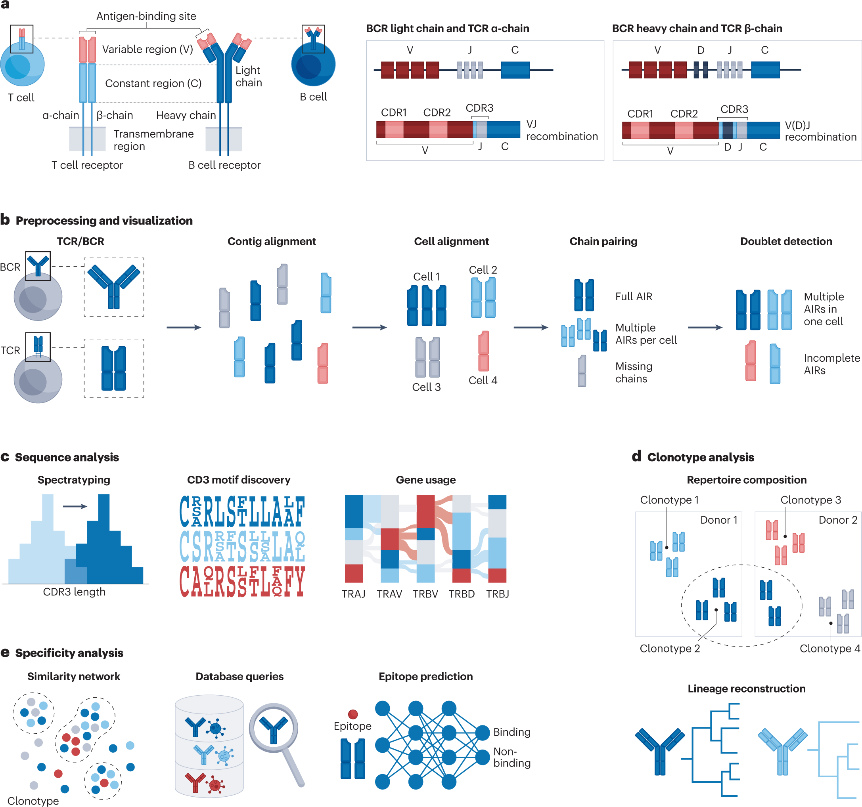
Fig. 5: Overview of the adaptive immune receptor analysis

